Slide 1


Certificate Presentation Deck
A Multi-Factor Access Control & Ownership Transfer Framework
Future Generation Healthcare Systems
Presented by Dr. Anubha Parashar
4th International Conference on Opportunities and Challenges in Business Management (OCBM 2020)
Manipal Academy of Higher Education, Dubai • 25–26 February 2020
Healthcare IoT
Edge Computing
Access Control
Notes:
Opening slide built from uploaded certificate image and paper title.

Slide 2
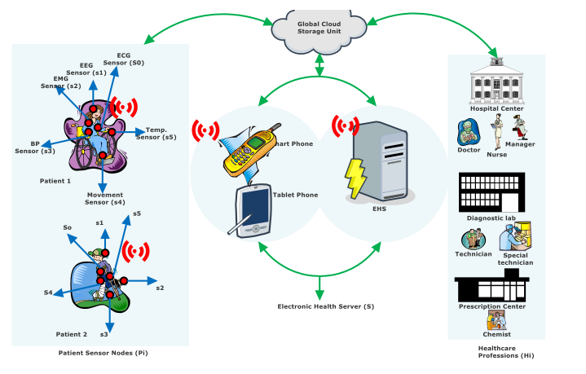
RESEARCH SNAPSHOT
Paper at a glance
Securing connected healthcare where devices, users, and data constantly move.
3
4
5+
system entities
Patient • Professional • EHS
protocol phases
E • S • AKE • OTP
attack classes
formally/informally assessed
The work proposes a lightweight, multi-factor framework for IoMT environments that combines access control, authentication, key exchange, and ownership transfer.
Core contribution
A protocol that lets authorized healthcare users transfer/revoke access rights while preserving patient privacy and system resilience.
OCBM 2020 • Healthcare IoT Security • Access Control + Ownership Transfer

Slide 3
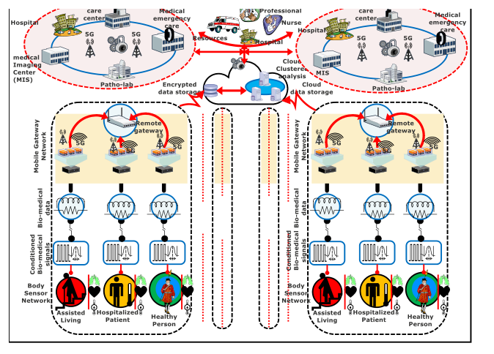
PROBLEM CONTEXT
Why healthcare IoT needs stronger access control
IoMT creates value—but also expands the attack surface.
Body sensors continuously send biomedical signals through wireless gateways.
Edge computing reduces latency and supports real-time clinical decisions.
Cloud/EHS storage centralizes data but increases privacy and authorization risk.
Healthcare users need controlled, auditable, and revocable access rights.
Design goal: secure access without overloading resource-constrained sensors
OCBM 2020 • Healthcare IoT Security • Access Control + Ownership Transfer

Slide 4
SECURITY GAP
Threat model and motivation
The model targets failures common in wireless, cloud-connected care.
01
02
03
04
Wireless exposure
Credential theft
Data manipulation
Emergency access
Sensitive biomedical packets travel across vulnerable channels and gateways.
RFID/smart card data and password guesses are realistic attacker paths.
Captured traffic can be edited, deleted, replayed, or used for traceability.
Break-glass access must work quickly without permanently weakening policy.
Motivation: combine authentication + access rights + ownership transfer in one lightweight protocol
OCBM 2020 • Healthcare IoT Security • Access Control + Ownership Transfer

Slide 5
SYSTEM VIEW
Proposed architecture
Three entities coordinate access securely.
Patient entity (Pi)
Healthcare sensor nodes attached to the patient capture physiological data.
Healthcare professional (Hi)
Doctors, nurses, lab technicians, chemists, and staff registered through smart radio cards.
Electronic health server (Si)
EHS, gateways, and cloud infrastructure enforce policy, keying, and data availability.
OCBM 2020 • Healthcare IoT Security • Access Control + Ownership Transfer

Slide 6
IMPLEMENTATION PHASES
Protocol flow
Access is granted through a staged, policy-aware flow.
1
2
3
4
Enrollment (E)
Sign-In (S)
Authentication & Key Exchange (AKE)
Ownership Transfer (OTP)
User ID + credentials + biometric data are bound to the smart card and EHS registration.
The user inserts the card, enters credentials, and supplies biometrics for matching.
Timestamps and computed messages verify legitimacy; a shared secret/session key is established.
Access rights move to a new legitimate user; old access is revoked but can be restored later.
Outcome: only verified users reach allocated EHS data segments, and rights can change safely over time
OCBM 2020 • Healthcare IoT Security • Access Control + Ownership Transfer

Slide 7
UNIQUE FEATURE
Ownership transfer and break-glass access
The framework supports real-world clinical handoffs.
H₁
EHS
H₂
In healthcare, access is not static. Doctors change, emergencies occur, and patient data must remain protected during every transition.
OTP transfer
Normal route
H₂ supplies credentials and biometrics. EHS validates the new owner and sends H₁ deregistration notification.
Registered professional authenticates with card + password + biometric match before accessing allocated data.
Revocation support
The previous user’s details remain stored for future revocation/restoration without exposing current owner privacy.
Emergency route
Break-glass access bypasses regular phases only for immediate response scenarios, preserving auditability.
OCBM 2020 • Healthcare IoT Security • Access Control + Ownership Transfer

Slide 8
FUNCTIONAL • SECURITY • PRIVACY
Requirements translated into design choices
The protocol is evaluated through three requirement families.
Functional
Security
Privacy
Access control
Policy-based authentication
Entity privacy
Energy optimization
Data confidentiality
User non-traceability
Break-glass access
Information integrity
Old owner privacy
Ownership transfer
Data availability
New owner privacy
Design principle: minimize sensor burden while preserving data ownership, access traceability, and patient confidentiality
OCBM 2020 • Healthcare IoT Security • Access Control + Ownership Transfer

Slide 9
RESILIENCE
Security analysis highlights
The framework is designed to resist common IoT attack paths.
✓
Stolen card attack
✓
Offline password guessing
Smart card alone is insufficient without user ID, password, and biometrics.
Critical parameters are additionally protected by biometric details.
✓
Insider attack
✓
DDoS + traceability
Policy-based server checks and cryptographic validation reduce unauthorized access.
Formal/informal analysis targets availability and user non-traceability.
Security message: multi-factor credentials + timestamp checks + hash-based protection strengthen access control in IoMT
OCBM 2020 • Healthcare IoT Security • Access Control + Ownership Transfer

Slide 10
Presentation certified at OCBM 2020
4th International Conference on “Opportunities and Challenges in Business Management”
Manipal Academy of Higher Education, Dubai
Key takeaway
Connected healthcare requires stronger identity and access governance.
Edge-enabled IoMT systems must balance latency, privacy, and energy limits.
Ownership transfer is a critical feature for clinical continuity.
Multi-factor authentication improves resilience against practical threats.
Thank you

